Slide 1



GROUP DATA CHALLENGE
- MIGROS STORES -
Jacques, Muchun, Patrizia
27.5.2022

Slide 2

TASK
-> find the best places to create new Migros stores

Slide 3
TASK
-> find the best places to create new Migros stores
Analyze market opportunities based on:

Slide 4
TASK
-> find the best places to create new Migros stores
Analyze market opportunities based on:
Density of existing stores

Slide 5


TASK
-> find the best places to create new Migros stores
Analyze market opportunities based on:
Density of existing stores

Slide 6
TASK
-> find the best places to create new Migros stores
Analyze market opportunities based on:
Density of existing stores
Presence of competitors

Slide 7





TASK
-> find the best places to create new Migros stores
Analyze market opportunities based on:
Density of existing stores
Presence of competitors

Slide 8
TASK
-> find the best places to create new Migros stores
Analyze market opportunities based on:
Density of existing stores
Presence of competitors
General population density

Slide 9
TASK
-> find the best places to create new Migros stores
Analyze market opportunities based on:
Density of existing stores
Presence of competitors
General population density
Income distribution
Social status of population

Slide 10
TASK
-> find the best places to create new Migros stores
Analyze market opportunities based on:
Density of existing stores
Presence of competitors
General population density
Income distribution
Social status of population

Slide 11
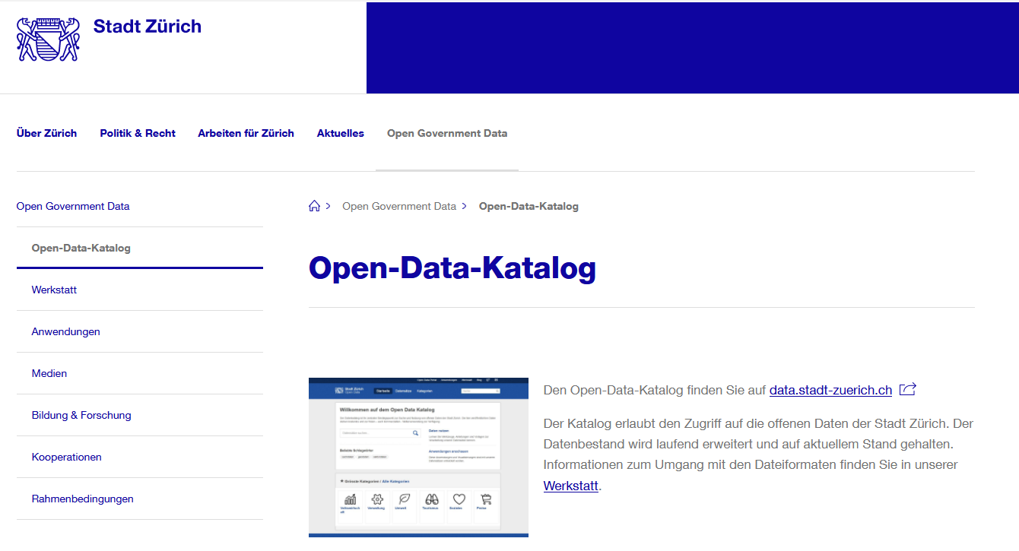
STRATEGY
Collecting data about population in Zürich:

Slide 12
STRATEGY
Collecting data about population in Zürich:
csv files

Slide 13
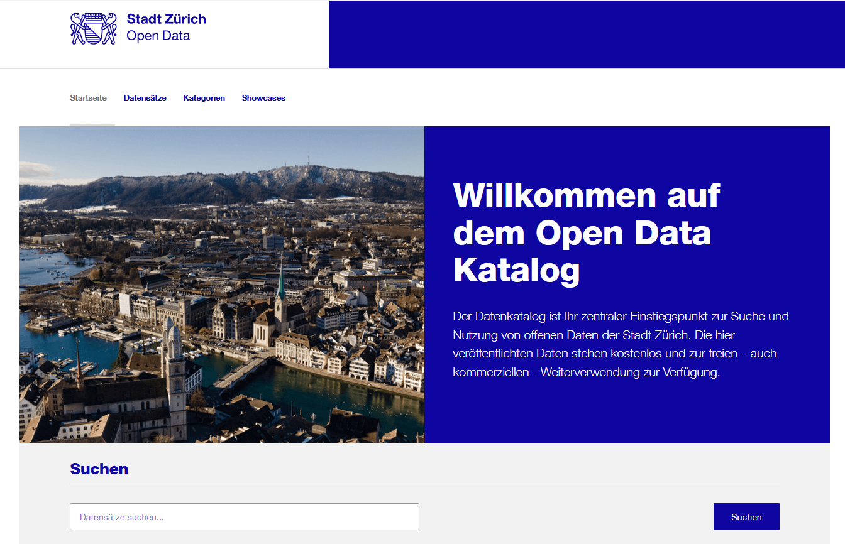
STRATEGY
Collecting data about population in Zürich:

Slide 14
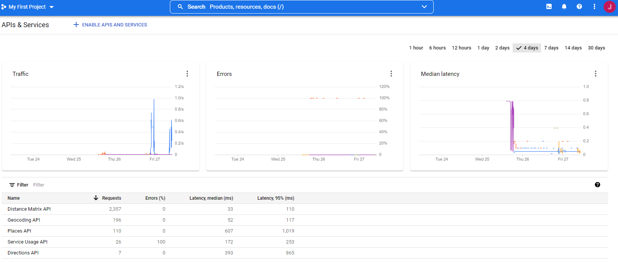
STRATEGY
Collecting data about locations of Migros stores and competitors in Zürich:
-> Google
API:

Slide 15
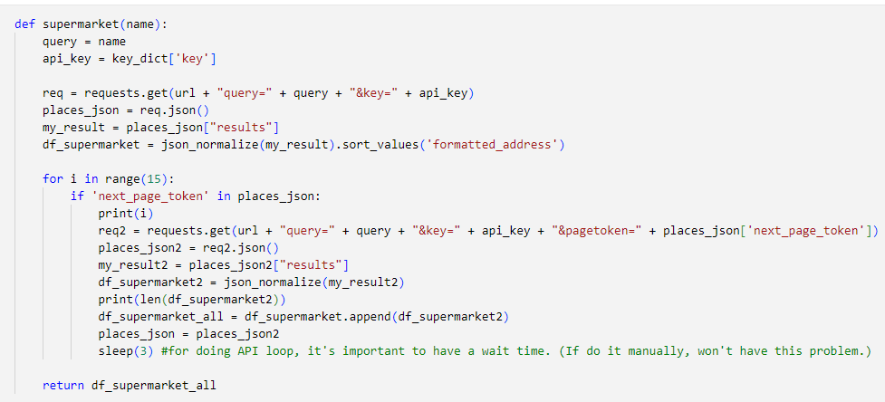
STRATEGY
Collecting data about locations of Migros stores and competitors in Zürich:
-> Google API:

Slide 16
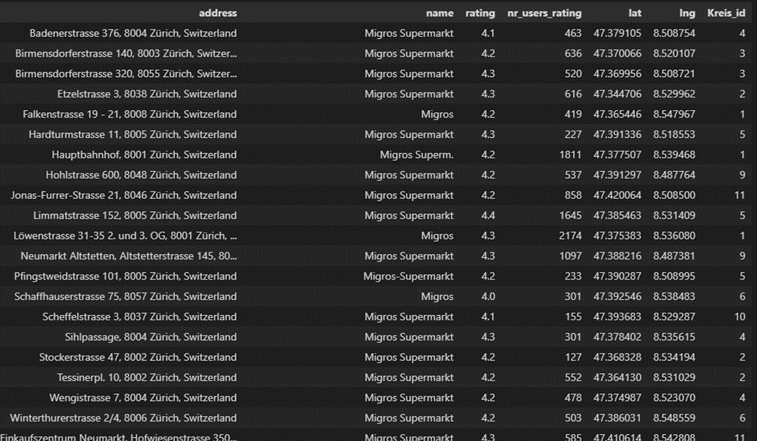
STRATEGY
Preparing the interactive webpage for data analysis:
-> Migros stores:

Slide 17
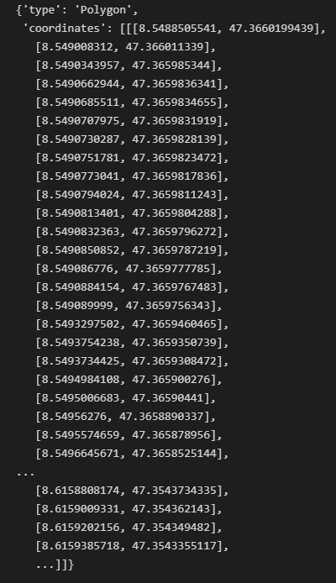
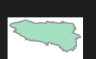
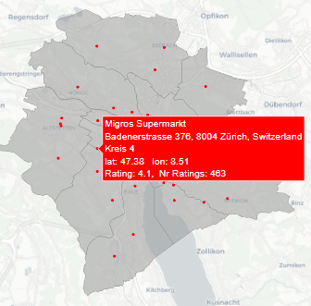
STRATEGY
Preparing the interactive webpage for data analysis:
-> polygons:

Slide 18
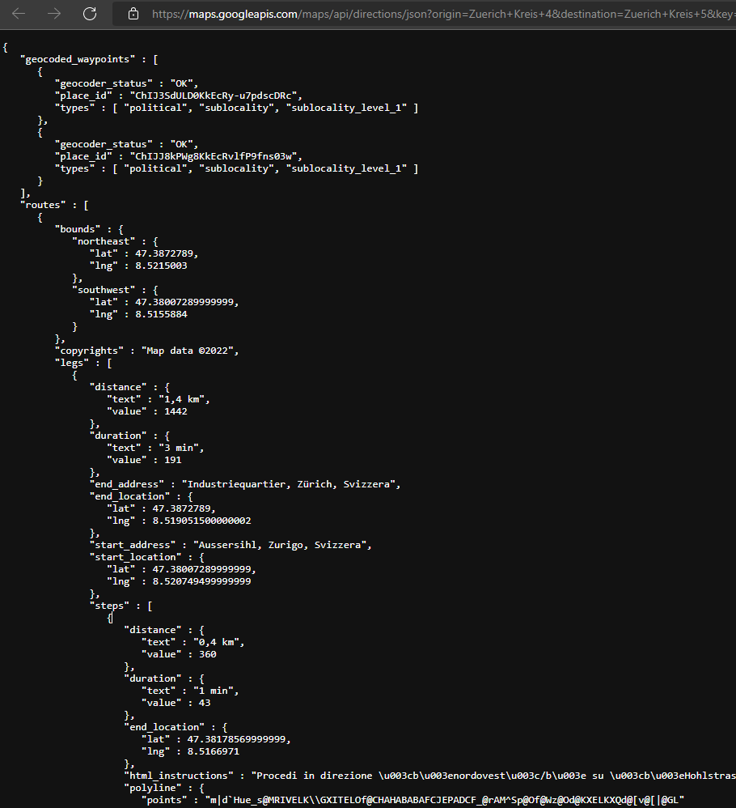
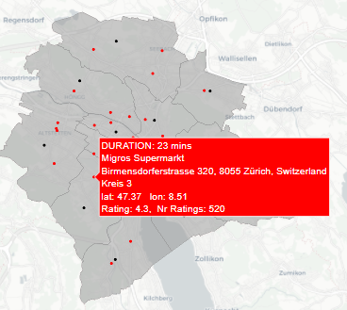
STRATEGY
Preparing the interactive webpage for data analysis:
-> Google maps
API:

Slide 19
RESULT: THE WEBPAGE
-> Let’s have a look at the web app

Slide 20
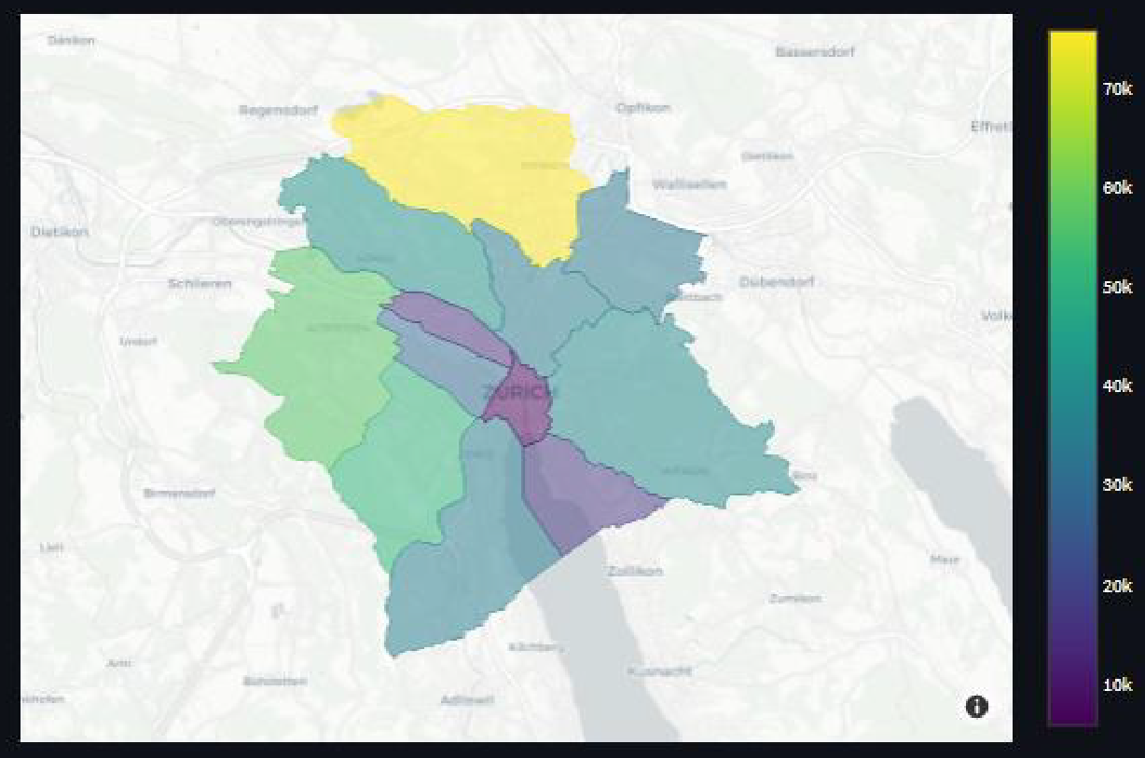
CONCLUSIONS
Population density in Zürich (by no. of inhabitants per «Kreis»):

Slide 21
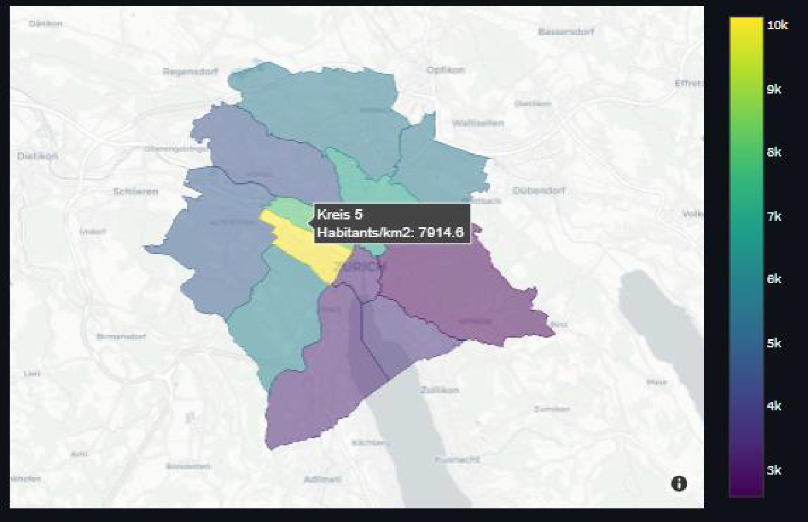
CONCLUSIONS
Population density in Zürich (by inhabitants/km²):

Slide 22
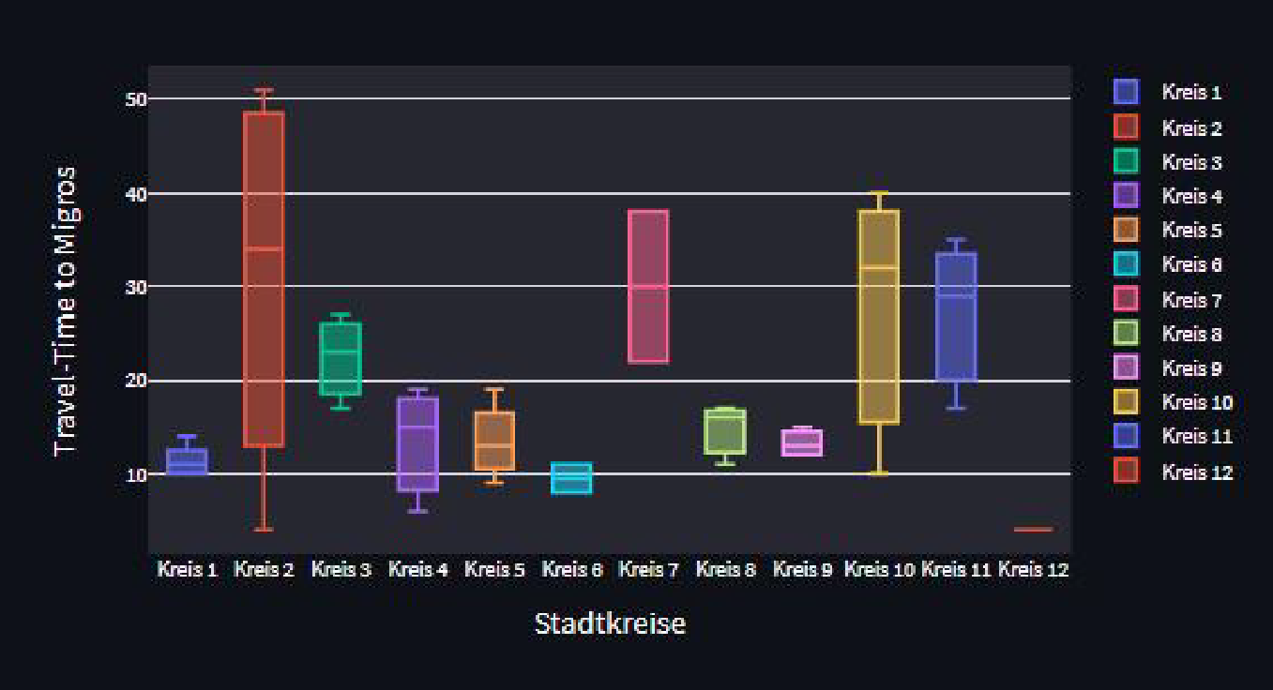
CONCLUSIONS
Travel time to Migros (here: walking):

Slide 23
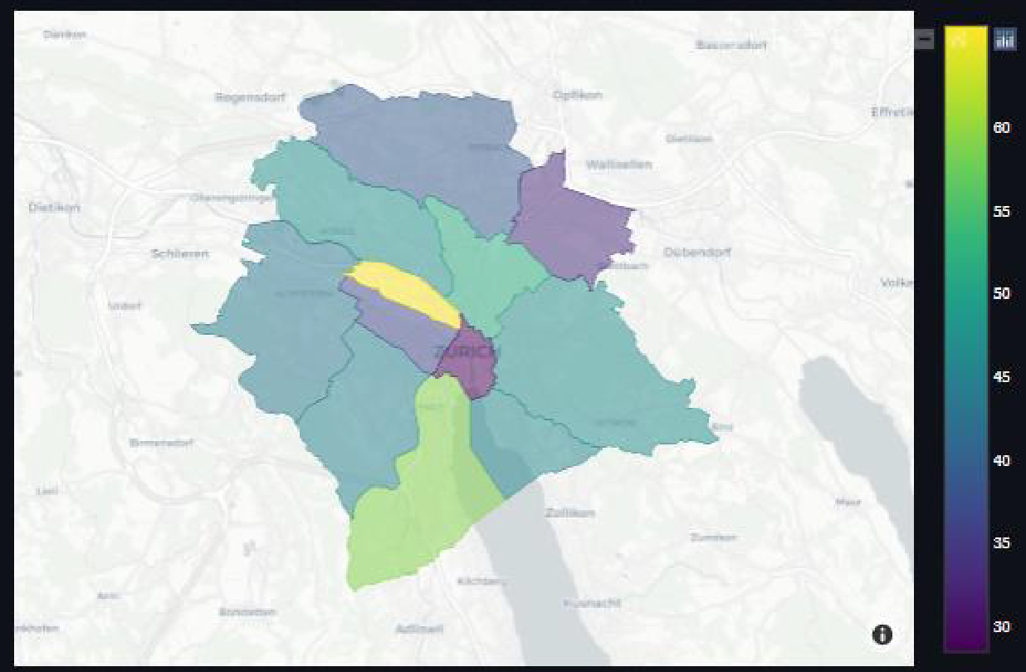
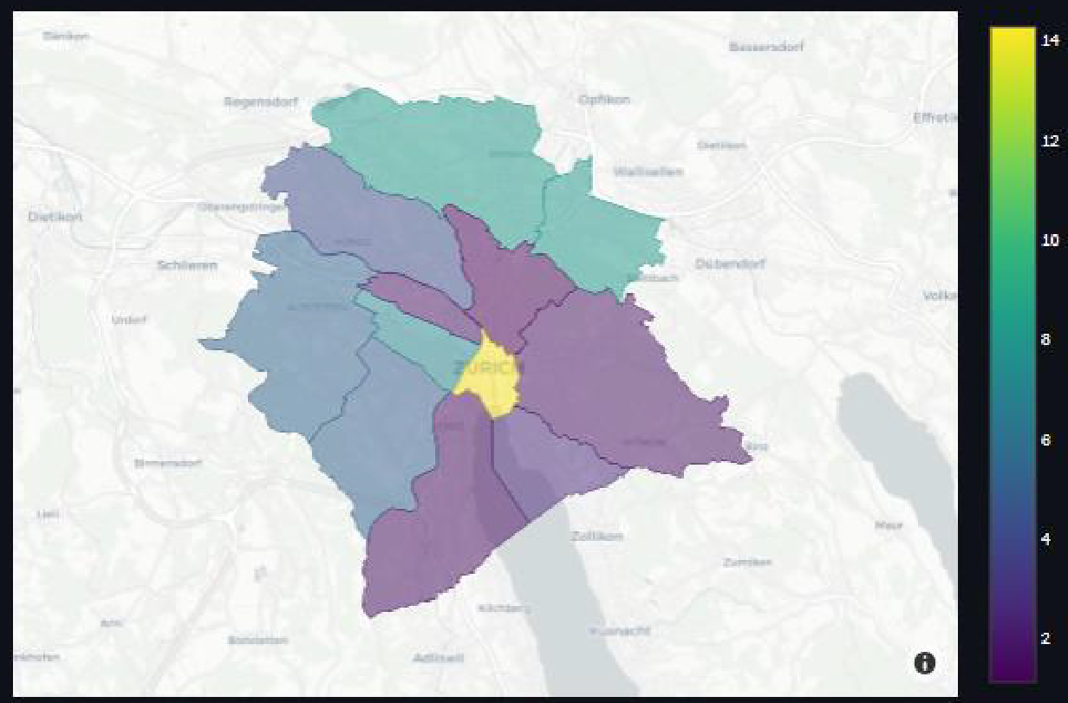
CONCLUSIONS
Monetary factors:
tax
Unemployment rate

Slide 24
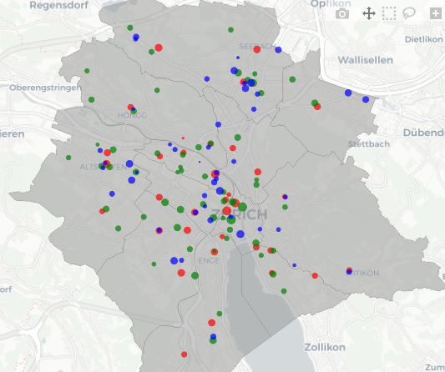
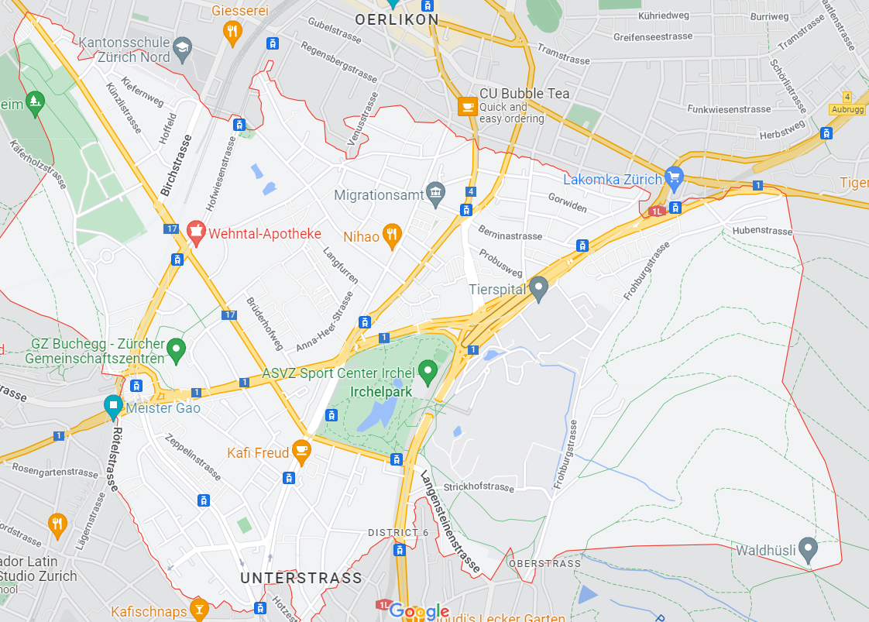
RECOMMENDATION
No supermarkets around circle
Convenient traffic connections
Average income comparably high in these three areas

